Slide 1

Presenting your findings
Dan Weinberger, PhD

Slide 2
Outline for this presentation
Making nicer plots
Managing uncertainty in your results
What results should you show, and to whom?

Slide 3
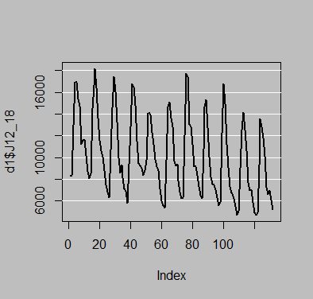
Plotting tips
(par(bg = 'gray'))
plot(d1$J12_18, type=‘l’, lwd=2)
abline(h=seq(from=6000,to=20000, by=2000), col='white')

Slide 4
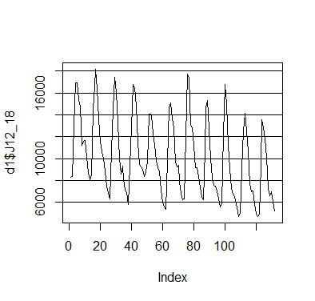
Get rid of gray background
(par(bg = 'white'))
plot(d1$J12_18, type='l')
abline(h=seq(from=6000,to=20000, by=2000), col='black')

Slide 5
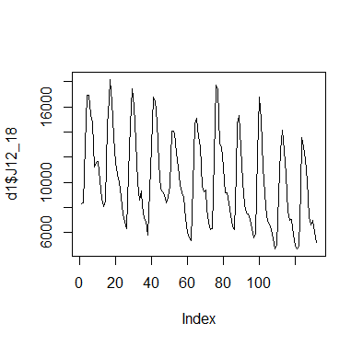
Get rid of horizontal guidelines “Chart junk”
plot(d1$J12_18, type='l')

Slide 6
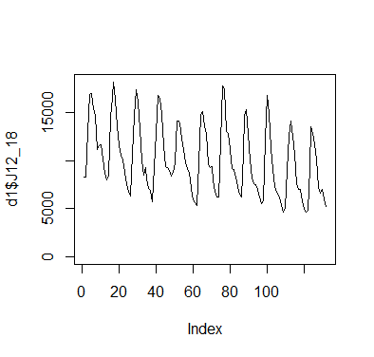
Extend y axis to 0
plot(d1$J12_18, type='l', ylim=c(0, max(d1$J12_18)))

Slide 7
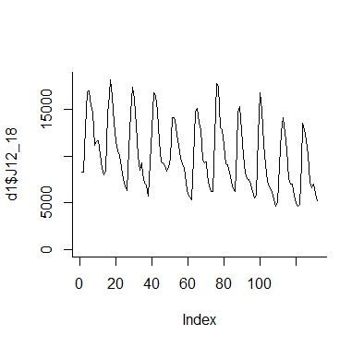
Remove unnecessary borders
plot(d1$J12_18, type='l', ylim=c(0, max(d1$J12_18)), bty='l')

Slide 8
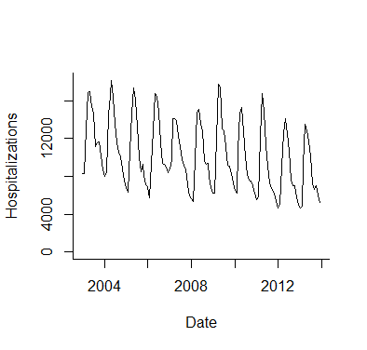
Fix axes
plot(as.Date(d1$date),d1$J12_18, type='l', ylim=c(0, max(d1$J12_18)), bty='l',
ylab="Hospitalizations", xlab='Date', xaxt='n', yaxt='n')
date.labs<- as.Date(c("2004-01-01",'2006-01-01','2008-01-01', '2010-01-01','2012-01-01','2014-01-01'))
axis(side=1, at=date.labs, labels=c("2004","2006","2008","2010","2012","2014"))
axis(side=2, at=seq(from=0,to=20000, by=4000), labels=T)

Slide 9
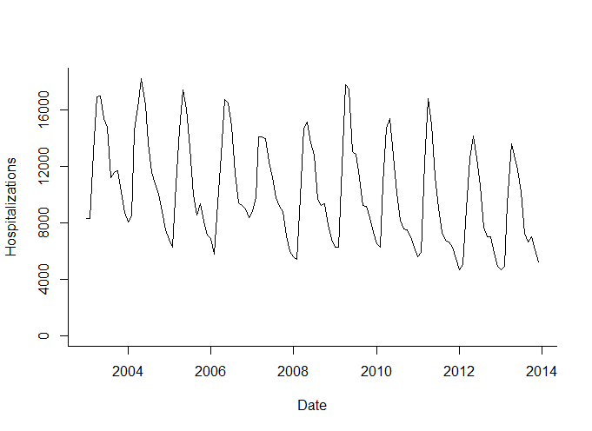
Stretch x-axis

Slide 10
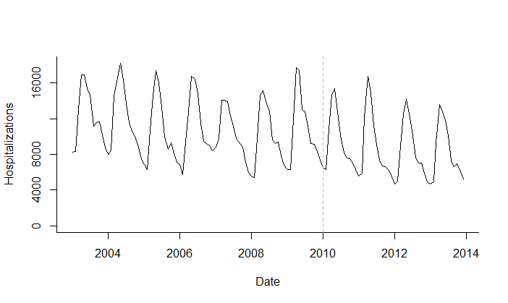
Add ref line
abline(v=(as.Date("2010-01-01")), lty=2, col='gray')

Slide 11
Increase resolution
tiff('C:\\Users\\dmw63\\Desktop\\finalplot.tif', width =6, height = 4, units = "in",res=800)
plot(as.Date(d1$date),d1$J12_18, type='l', ylim=c(0, max(d1$J12_18)), bty='l',
ylab="Hospitalizations", xlab='Date', xaxt='n', yaxt='n')
date.labs<- as.Date(c("2004-01-01",'2006-01-01','2008-01-01', '2010-01-01','2012-01-01','2014-01-01'))
axis(side=1, at=date.labs, labels=c("2004","2006","2008","2010","2012","2014"))
axis(side=2, at=seq(from=0,to=20000, by=4000), labels=T)
abline(v=(as.Date("2010-01-01")), lty=2, col='gray')
dev.off()

Slide 13
Using colors
http://colorbrewer2.org
RColorBrewer package
library(RColorBrewer)
display.brewer.all()
pal1<- brewer.pal(4, 'Set1’) #4 color palette from color Set1

Slide 14
library(RColorBrewer)
display.brewer.all()
pal1<- brewer.pal(4, 'Set1')
tiff('C:\\Users\\dmw63\\Desktop\\finalplot.tif', width =6, height = 4, units = "in",res=800)
plot(as.Date(d1$date),d1$J12_18, type='l', ylim=c(0, max(d1$J12_18)), bty='l',
ylab="Hospitalizations", xlab='Date', xaxt='n', yaxt='n')
points(as.Date(d1$date), d1$A00_A09, col=pal1[1], type='l')
points(as.Date(d1$date), d1$E00_99, col=pal1[2], type='l')
points(as.Date(d1$date), d1$I00_99, col=pal1[3], type='l')
points(as.Date(d1$date), d1$ach_noj, col=pal1[4], type='l')
date.labs<- as.Date(c("2004-01-01",'2006-01-01','2008-01-01', '2010-01-01','2012-01-01','2014-01-01'))
axis(side=1, at=date.labs, labels=c("2004","2006","2008","2010","2012","2014"))
axis(side=2, at=seq(from=0,to=20000, by=4000), labels=T)
abline(v=(as.Date("2010-01-01")), lty=2, col='gray')
dev.off()

Slide 15
Keys for presentations
Make a credible, transparent of the analyses
Technical detail must be appropriate for audience
Use graphs and summary statistics sparingly but strategically

